Slide 1
Deep Reinforcement Learning
Meili Liu
Notes:
Hot, achieve great success

Slide 2
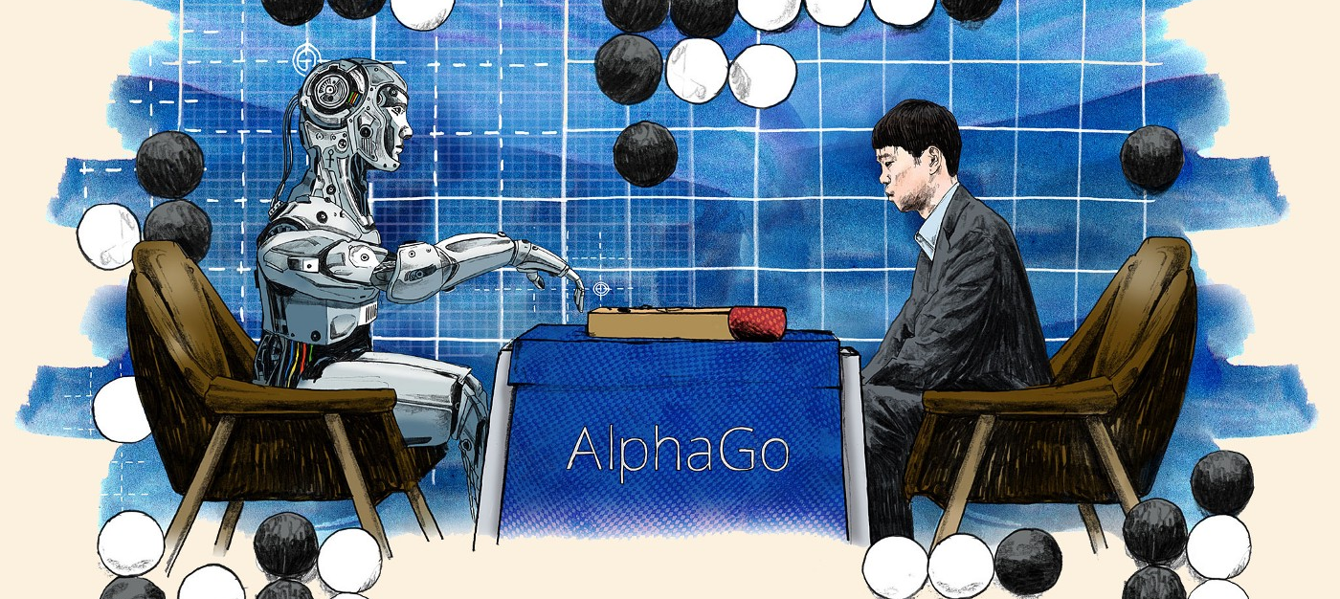
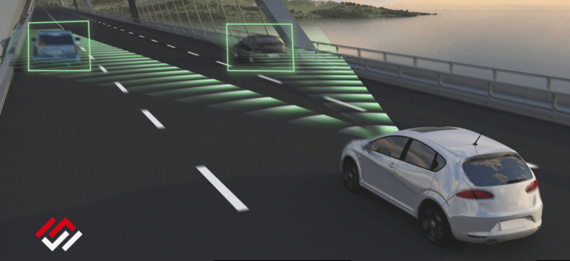
Reinforcement Learning: AlphaGo and Autonomous Driving

Slide 3
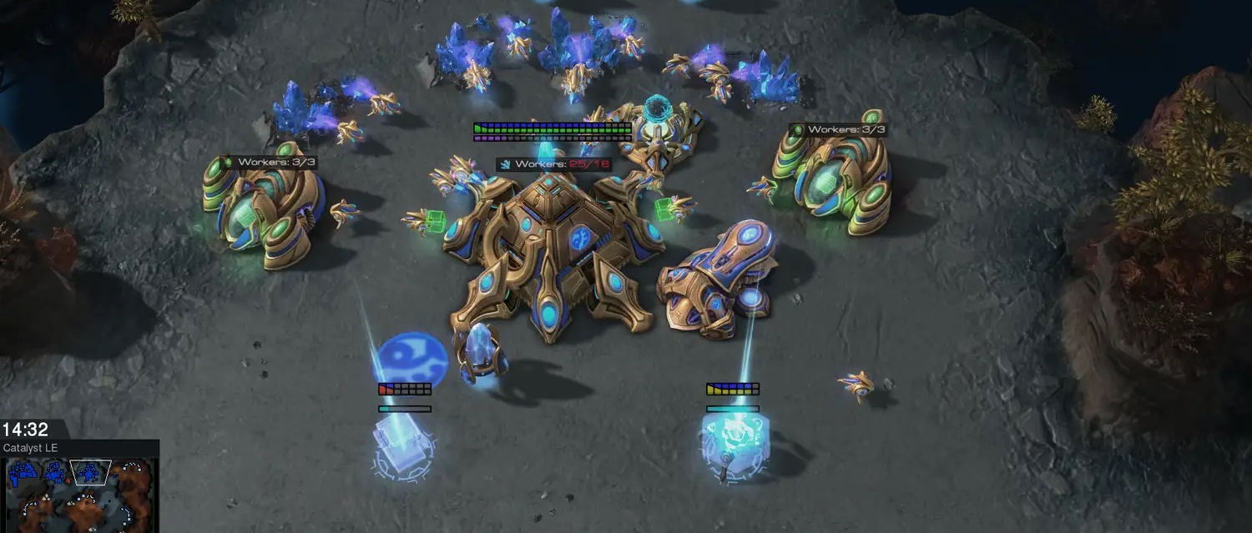
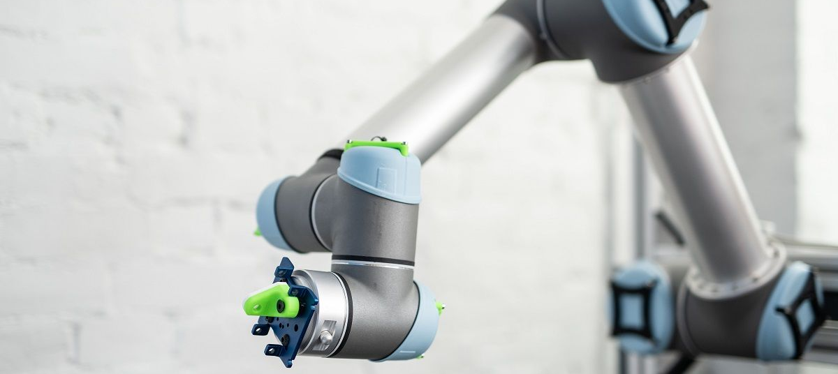
Reinforcement Learning: Game playing and Robot

Slide 4
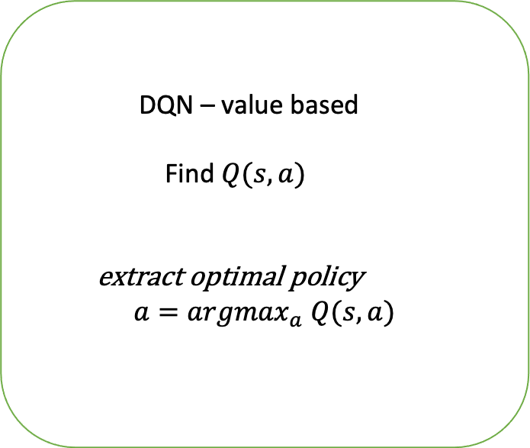

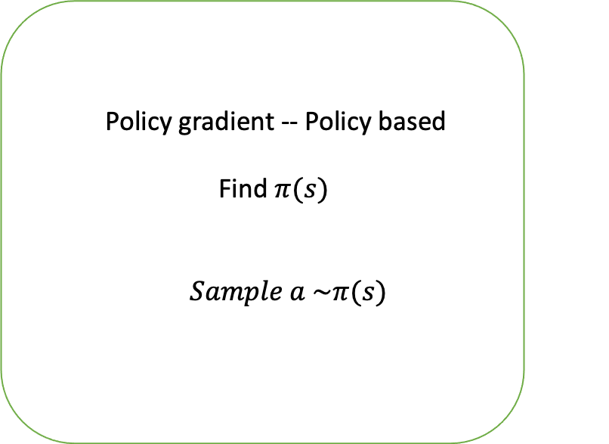
Deep Reinforcement Learning Algorithm
DQN – value based
Find $Q(s,a)$
extract optimal policy
$$a={argmax}_{a} Q(s,a)$$
Policy gradient -- Policy based
Find $π(s)$
$Sample a \sim π(s)$

Slide 5
Deep Reinforcement Learning Algorithm
DQN – value based
Find $Q(s,a)$
extract optimal policy
$$a={argmax}_{a} Q(s,a)$$

Slide 6
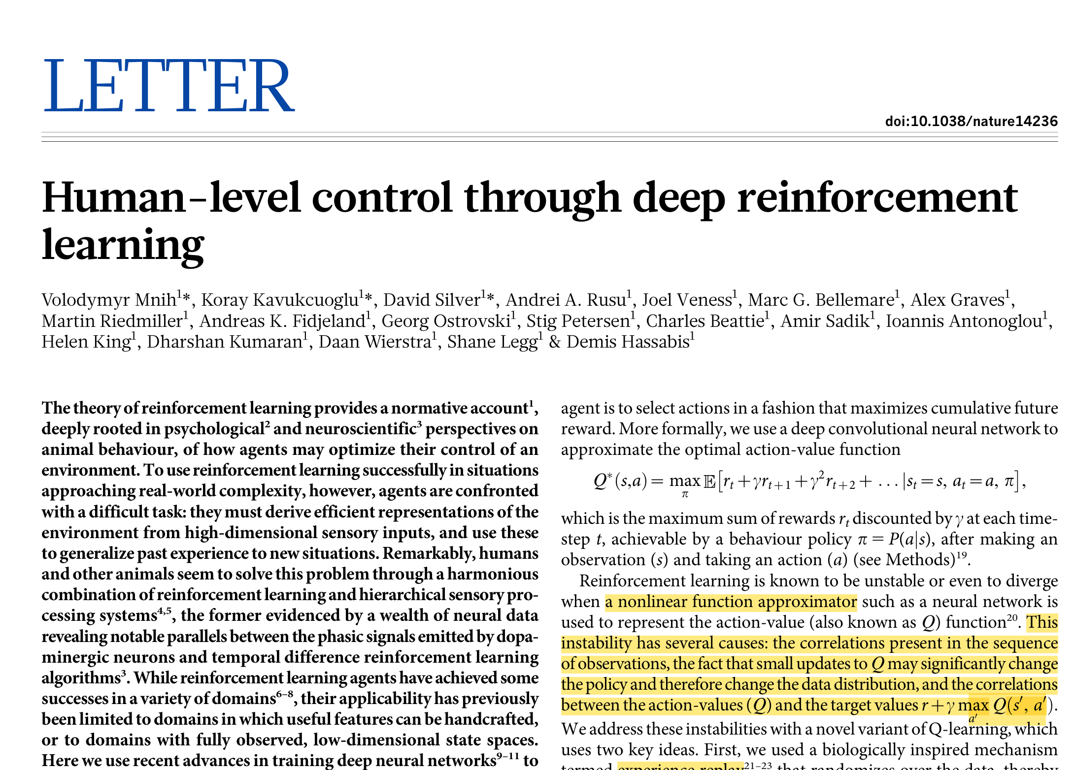
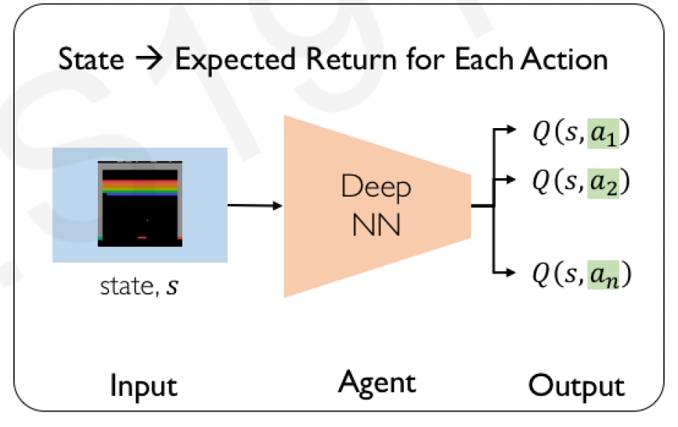
Deep Q-Network (DQN)
Figure 1. DeepMind paper for DQN
Figure 2. the diagram of DQN

Slide 7
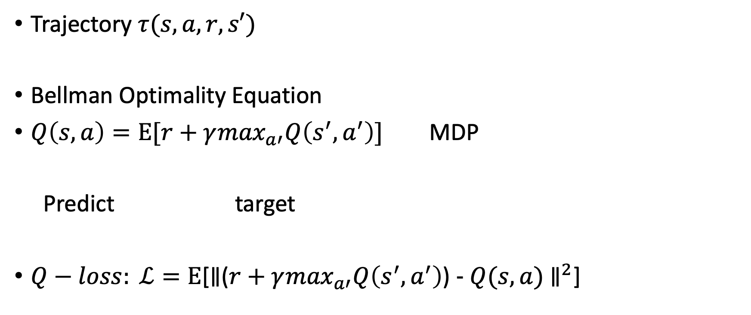
Key: How to compute the loss
Trajectory $τ(s,a,r,s′)$
Bellman Optimality Equation
$Q\left(s,a\right)=Ε[r+γ\max_{a′}Q\left(s^{′},a^{′}\right)]$ MDP
Predict target
$Q−loss: ℒ=Ε$[$∥$($r+γ\max_{a′}Q\left(s^{′},a^{′}\right)$)$- Q(s,a)$ $∥^{2}$]

Slide 8
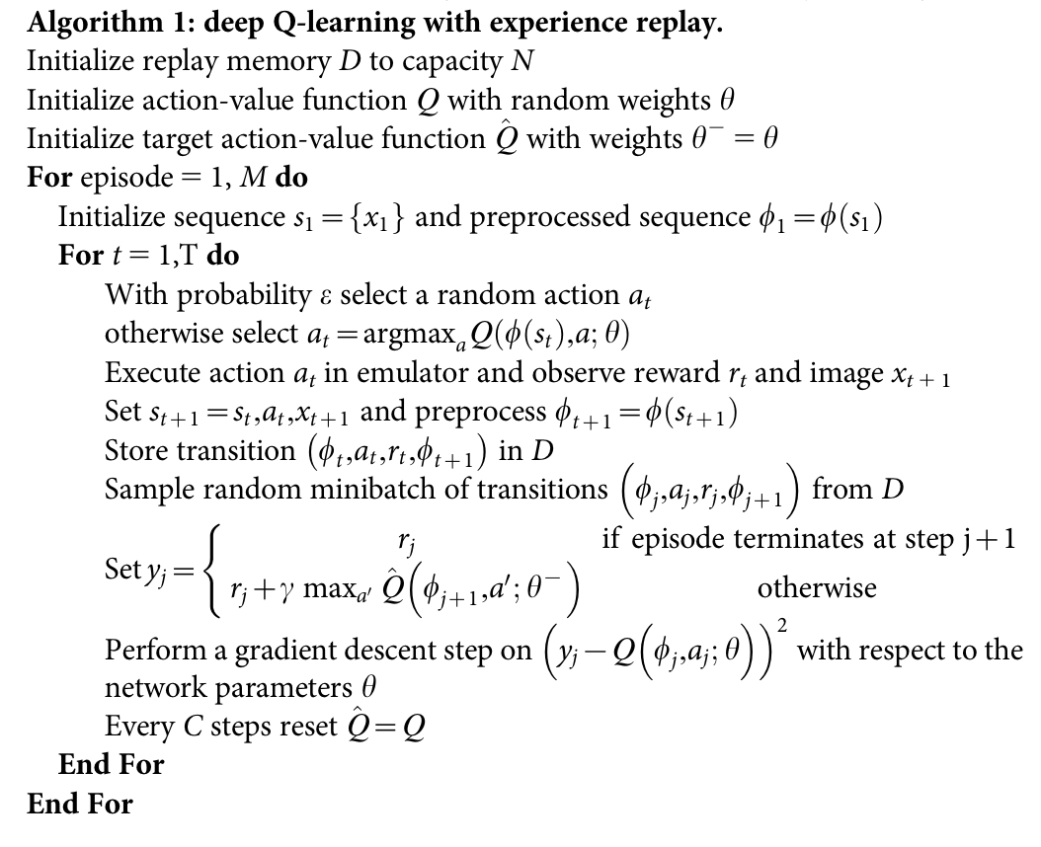
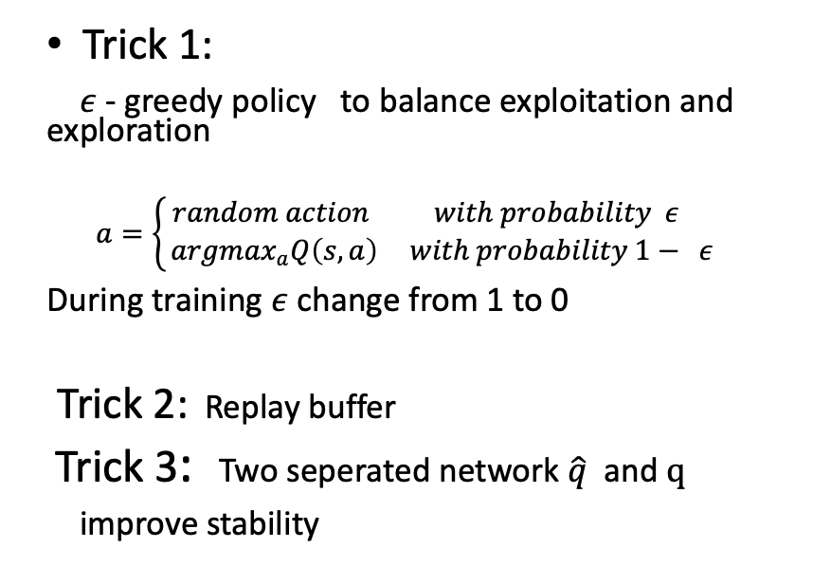
DQN-Algorithm
Trick 1:
$ε$ - greedy policy to balance exploitation and exploration
$$a=\left\{\begin{aligned} random action with probability ε \\ {argmax}_{a}Q\left(s,a\right) with probability 1− ε \end{aligned}\right.$$
During training $ε$ change from 1 to 0
Trick 2: Replay buffer
Trick 3: Two seperated network $\hat{q}$ and $q$
improve stability

Slide 9
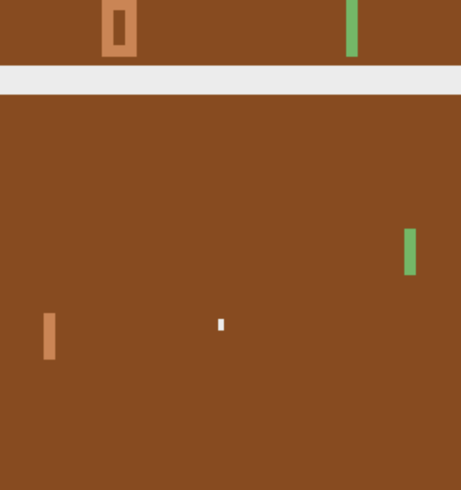
Experiment: training DQN on Atari Pong Environment
We control the right paddle, competing against the left paddle controlled by the computer. If we miss the ball, the left one would get one point, vice versa.
Continuous Observation Space:
dimensions (210,160,3)
6 Discrete Action
(Noop, Fire, Right, Left, RightFire, LeftFire)
Figure 3. PongDeterministic-v4 environment

Slide 10
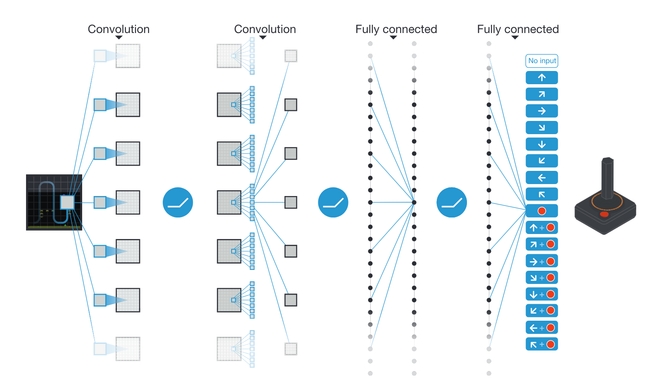
experiment
Model architecture:
Optimizer: Adam 1e-4
 | size | stride | activation
Convolution layer | 4*8*8*32 | 4 | ReLu
Convolution layer | 32*4*4*64 | 2 | ReLu
Convolution layer | 64*3*3*64 | 1 | ReLu
Fully-connected layer | 512 |  | ReLu
Fully-connected layer | 6
Optimizer: Adam | 1e-4
Figure 5. Model architecture from original paper

Slide 11
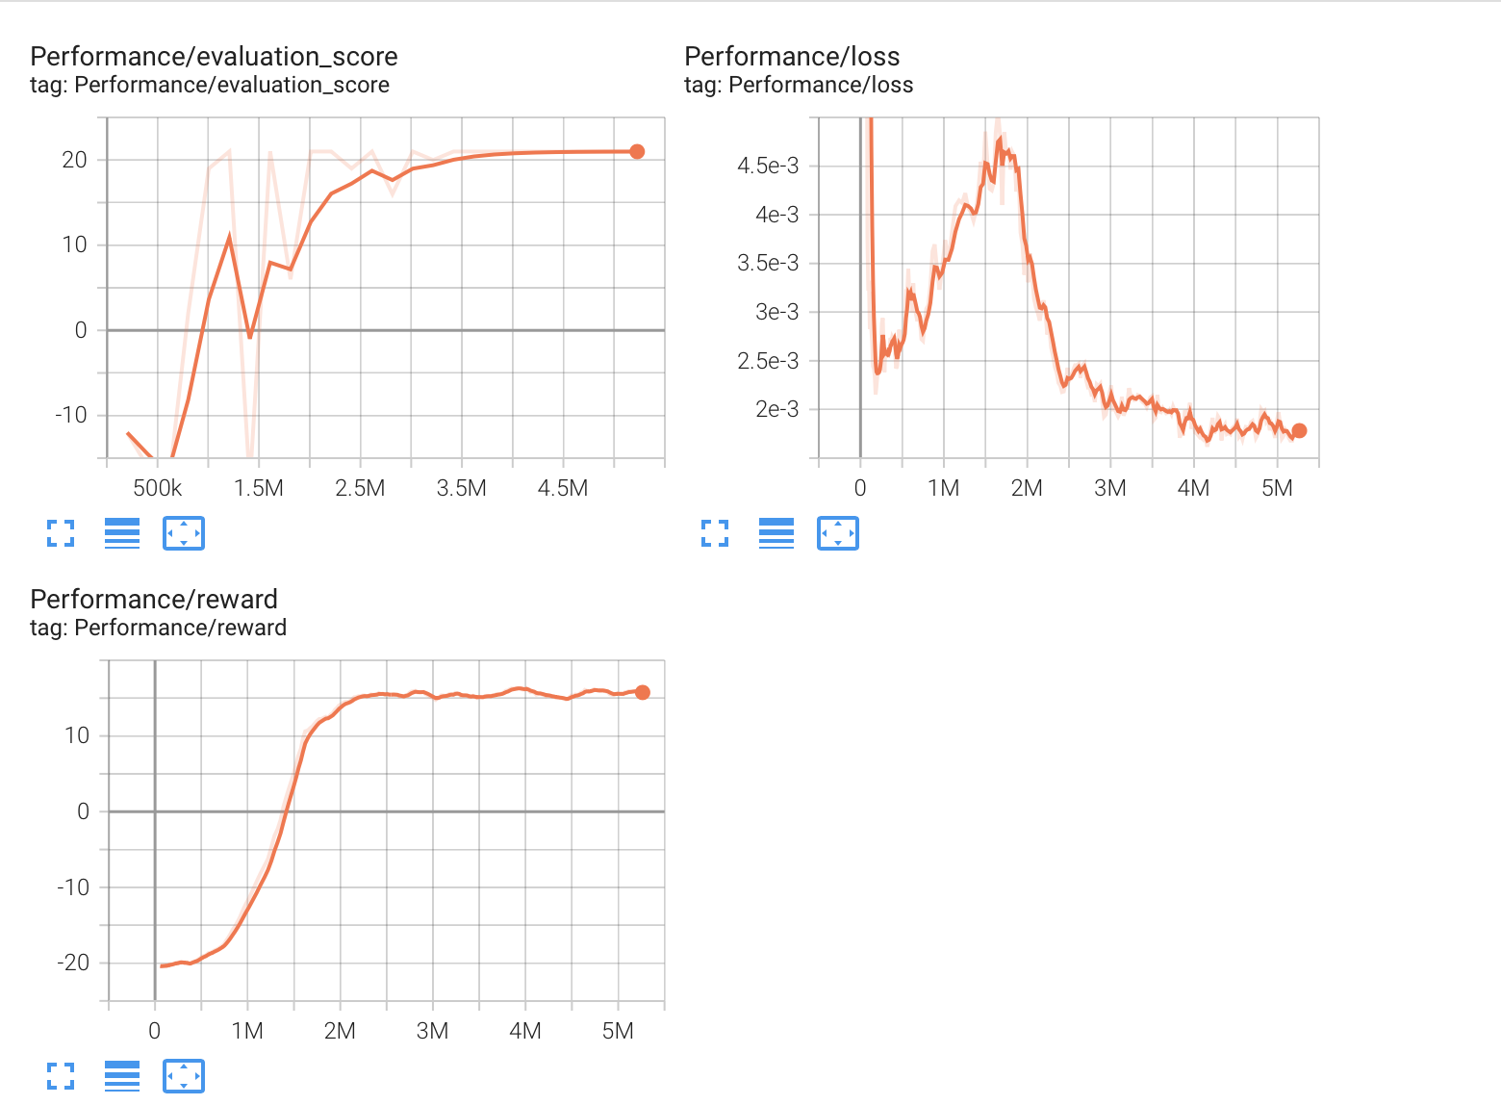
Result
Figure 6. Training curve for DQN on Atari/Pong

Slide 12
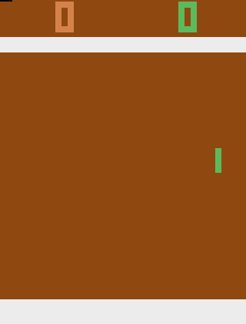
Results
Figure 7. At the beginning of training. Score:-19
Figure 8: At the end of training. Socre : 21

Slide 13
Downsides of Q-learning
Cannot handle continuous action spacs
Cannot learn stochastic policies
Figure 2. the diagram for DQN

Slide 14
Deep Reinforcement Learning Algorithm
Policy gradient -- Policy based
Find $π(s)$
$Sample a \sim π(s)$

Slide 15
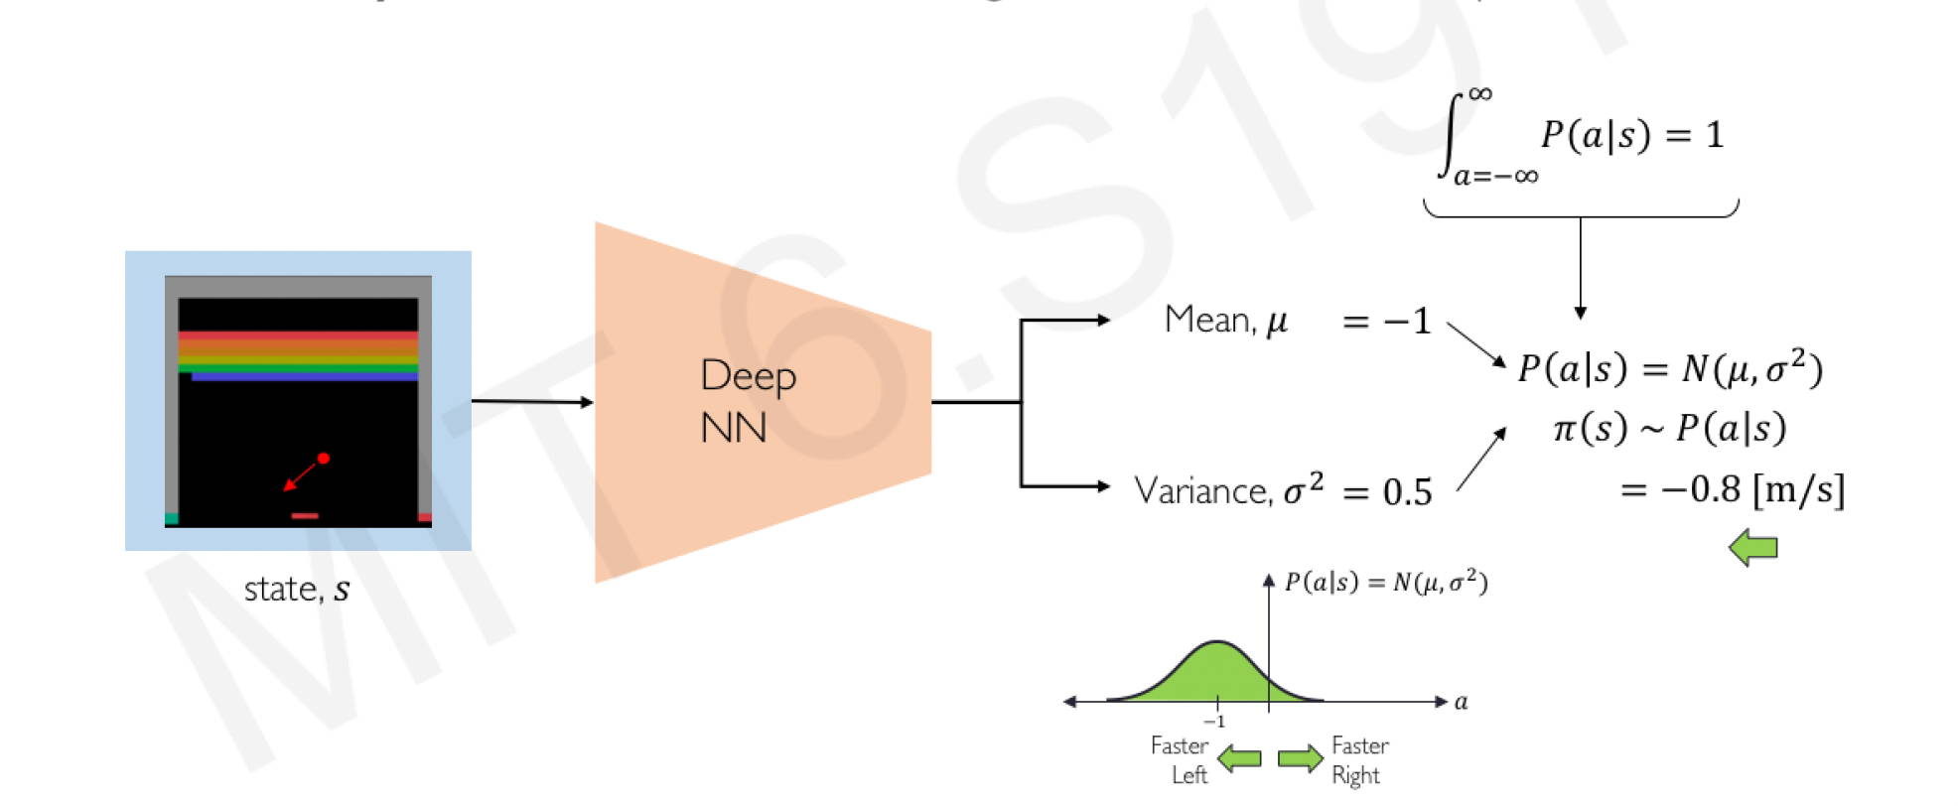
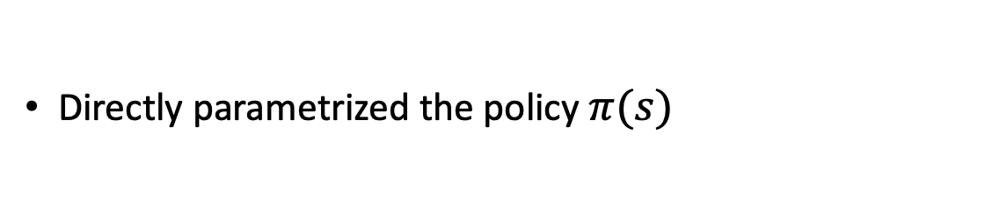
Policy Gradient
Directly parametrized the policy $π(s)$
Figure 9. the diagram for Policy Gradient

Slide 16
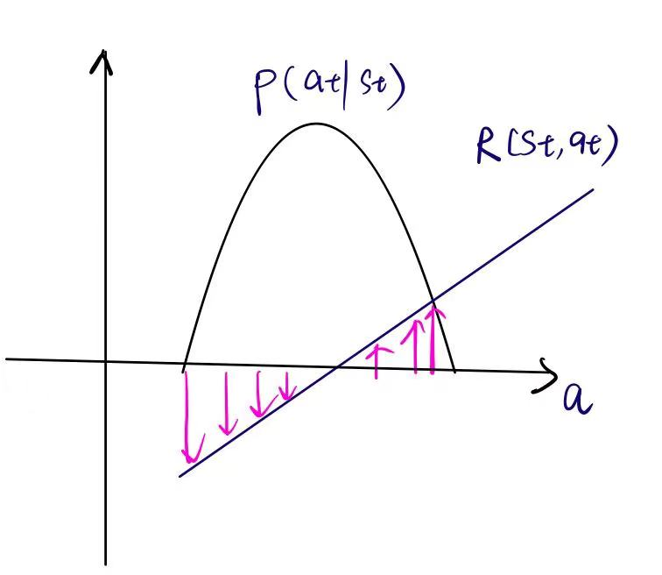
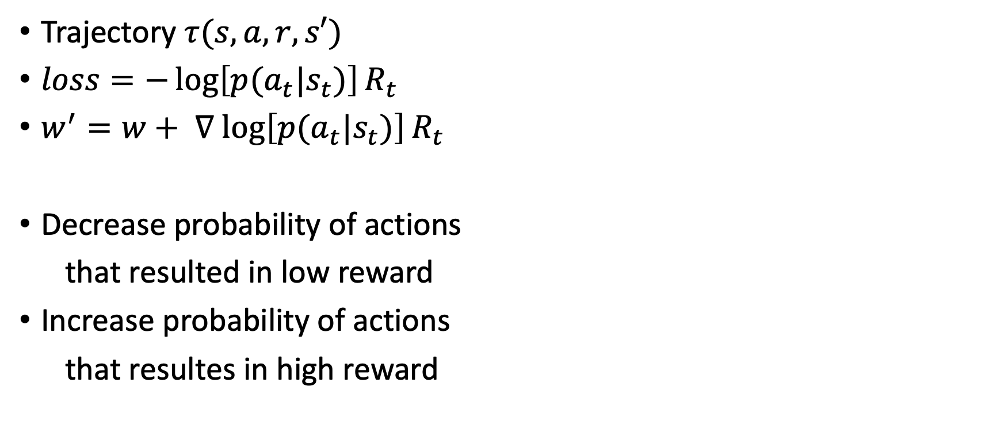
Key: how to compute loss function
Trajectory $τ(s,a,r,s′)$
$loss=−\log\left[p{(a}_{t}|s_{t})\right]R_{t}$
$w^{′}=w+ ∇$ $\log\left[p{(a}_{t}|s_{t})\right]R_{t}$
Decrease probability of actions
that resulted in low reward
Increase probability of actions
that resultes in high reward
Figure 10. one-dimension action space

Slide 17
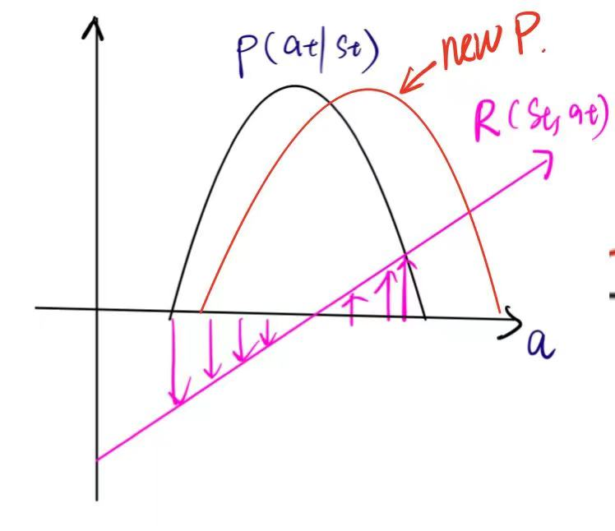
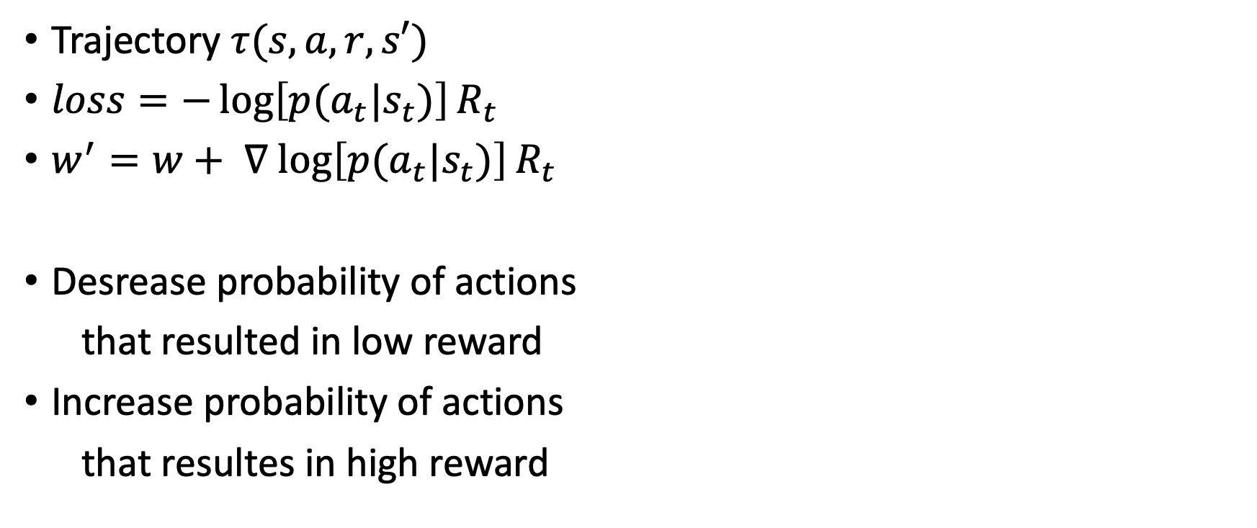
Training policy gradient
Trajectory $τ(s,a,r,s′)$
$loss=−\log\left[p{(a}_{t}|s_{t})\right]R_{t}$
$w^{′}=w+ ∇$ $\log\left[p{(a}_{t}|s_{t})\right]R_{t}$
Desrease probability of actions
that resulted in low reward
Increase probability of actions
that resultes in high reward
Figure 10. one-dimension action space

Slide 18
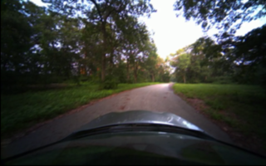
Experiment: training autonomous driving policy in VISTA
Environment Simulator: VISTA
Continuous observation space:
Stochastic action :
speed: fixed
curvature: reflects the car’s turn radius
Figure 11. Observation from VISTA

Slide 19
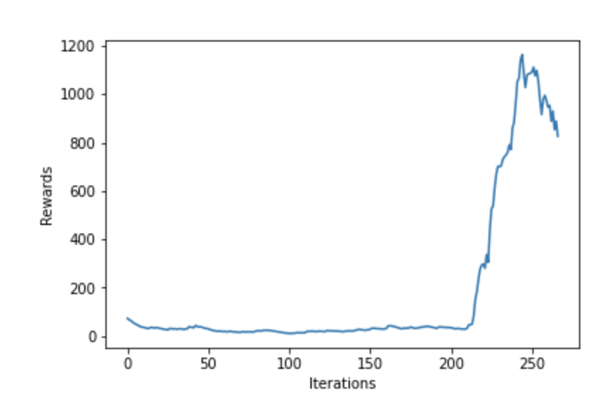
Experiment
Model architecture
Reward function: 0 for crash,
1 for not crash
MODEL ARCHITECTURE | size | stride | activation
Convolution layer | 3*5*5*32 | 2 | ReLu
Convolution layer | 32*5*5*48 | 2 | ReLu
Convolution layer | 48*3*3*64 | 2 | ReLu
Convolution layer | 64*3*3*64
Fully-connected | 128 |  | ReLu
Fully-connected | 2
Optimizer: Adam | 5e-4
Figure 12. rewards during training

Slide 20
Result
random action
After training

Slide 21
Thank you
Questions?

